Slide 1
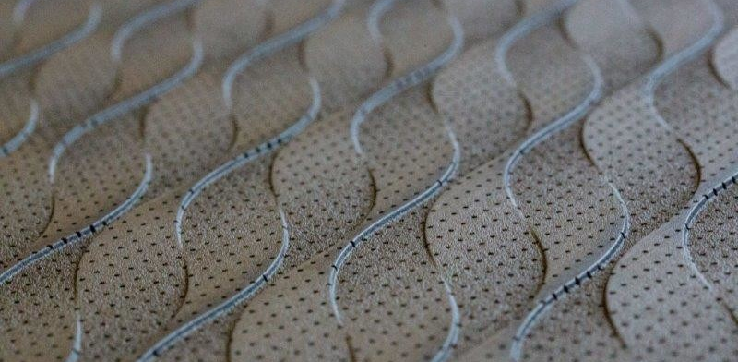
Optimizing Acoustic Properties of Microperforated Panels
D-INFK
Stefan Scholbe
Optimization Methods for Engineers
P. Leuchtmann

Slide 2
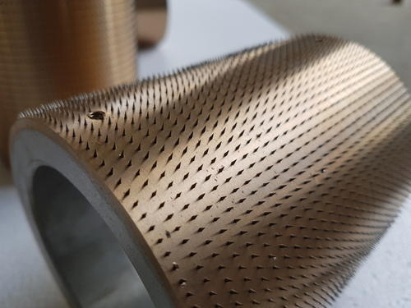
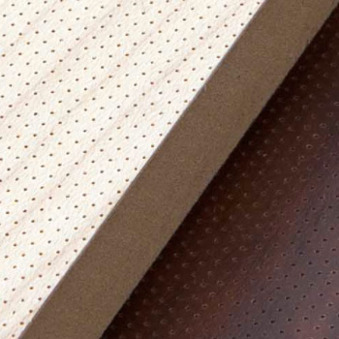
Microperforated Panels
“Panels with a lot of very small holes”
Effect of damping airborne sound when assembled distant to a wall
Mass-spring-damper model, like a Helmholtz resonator
Cheaper than glass wool, easy montage
Multiple layers have very promising potential
We focus on simpler case: Single Layer
Notes:
Microperforation in itself is nothing more than drilling very smal holes into panels. They become interesting as assembling it distant to a wall produces… As they are cheaper than glass wool and allow easy montage, they are interesting for the acoustic industry.
Helmholtz requires huge holes, which are visible at ease
Nadelwalze = needle roller
When applied in multiple layers…

Slide 3
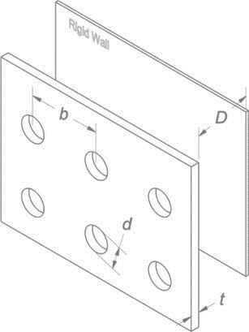
The Goal
“Maximize the absorption effects!”
Which properties influence it the most?
→ Theory by Dah-You Maa, 1950s
Perforation and installation can be broken down into four parameters:
Hole diameter
Hole frequency/distance
Thickness of the panel
Distance to the wall
Notes:
We can now start to concretize the problem.
Crystallize four parameters which seem to influence the absorption rate of the panels the most.
Needle rollers are expensive
Until we find a “good” perforation with high absorption at some desired frequency

Slide 4
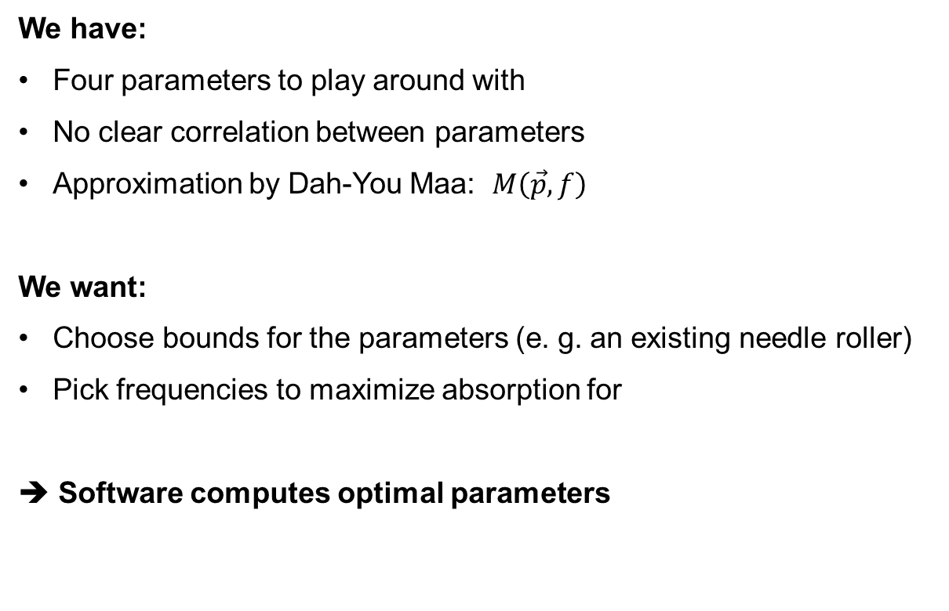
Microperforation as an Optimization Problem
We have:
Four parameters to play around with
No clear correlation between parameters
Approximation by Dah-You Maa: $M\left(\vec{p},f\right)$
We want:
Choose bounds for the parameters (e. g. an existing needle roller)
Pick frequencies to maximize absorption for
➔ Software computes optimal parameters
Notes:
We then want the software to compute the optimal parameters. This is where the optimization comes into play.
(i.e. what can be manufactured, what is available?)
(depending on application, for example car sounds at 500 HZ or human voice at around 1500Hz)

Slide 5

What is a solution?
Solution is described by four real numbers
The search space is spanned by the upper and lower bounds (while respecting the $b≥d$ constraint)
→ $D_{s}⊂ℝ^{4}$

Slide 6
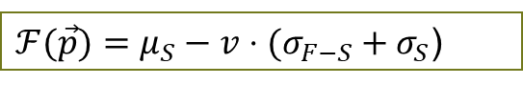

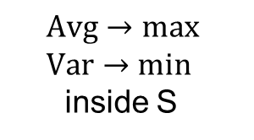
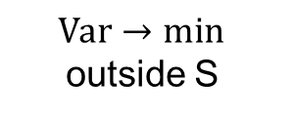

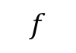
What is a good solution?
Compute the absorption curve for all “Terz” frequencies
The user chose a set of frequencies $S$ for which to maximize the absorption
Problem: “hilly” absorption curves change sound character of the room
→ Introduce factor $v$ to punish variance
$$Avg→max \\ Var→min$$
inside S
$$α$$
$ℱ(\vec{p})=μ_{S}−v⋅(σ_{F−S}+σ_{S}$)
S
$$f$$
$$Var→min$$
outside S
Notes:
To every optimization problem, one has to define, what a good solution has to look like.
If we optimize blindly for maximum, we can get a hilly plot like this.
What we want is a broad coverage. Wether this is actually physically possible, has yet to be found.

Slide 7
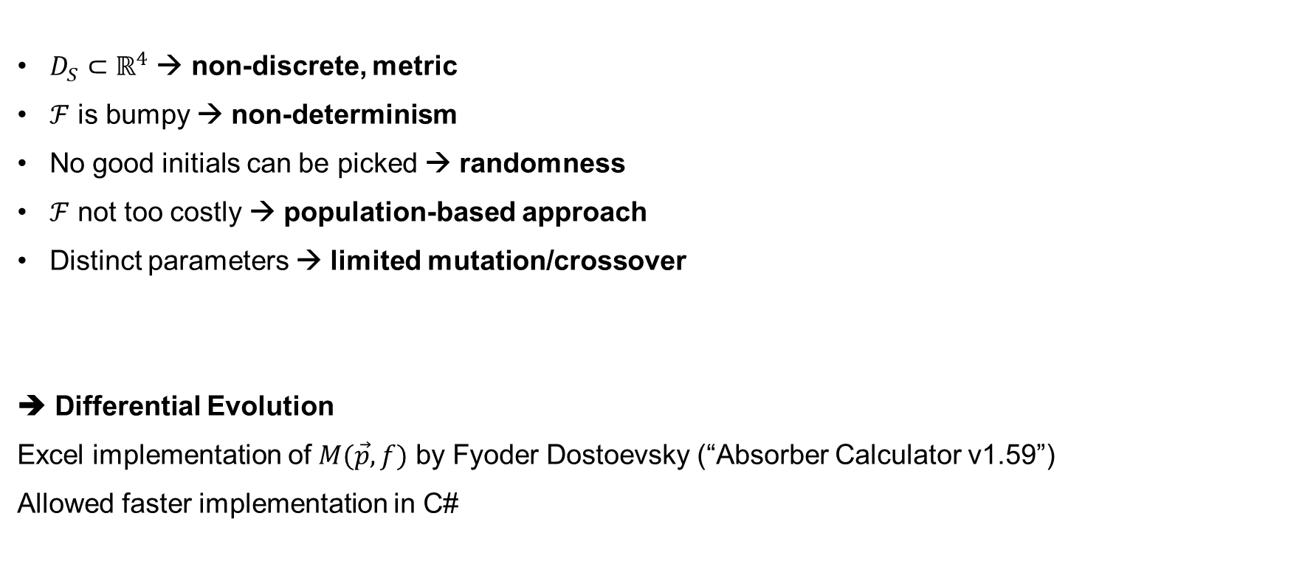
Which Optimization Strategy?
$D_{S}⊂ℝ^{4}$ → non-discrete, metric
$ℱ$ is bumpy → non-determinism
No good initials can be picked → randomness
$ℱ$ not too costly → population-based approach
Distinct parameters → limited mutation/crossover
➔ Differential Evolution
Excel implementation of $M(\vec{p},f)$ by Fyoder Dostoevsky (“Absorber Calculator v1.59”)
Allowed faster implementation in C#
Notes:
Randomness especially since sticking to bounds occurs
Clearly Non-linear, parameter (non-discrete)
Noisy: many optima? → kills deterministic approach
No good initials: require randomness → kills deterministic approach
F not too costly: (because we limit to terz frequencies) allows population based approach
R^4 → metric, well-structued, mutation limited, use some geometric approach
Sticking to bounds (example: cavity depth): We want to explore entire DS
Distinct paremters: Genetic algorithms are too limited (how to define mutation?)

Slide 8
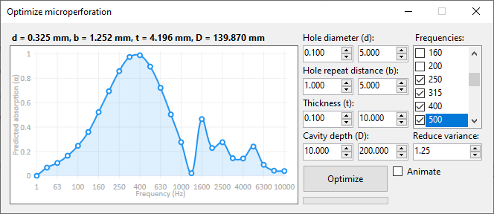
Result
Parameters as from the lecture, best of three à 200 iterations
…are we done?
Notes:
Slow changes of blue stuff means only bad candidates -> sign for too big room (i.e. too few N)

Slide 9
Recap: Differential Evolution
Generate a random population.
For each entity:
Geometrically construct (“shifting”) a candidate using three random entities
Recombine it and check whether we found a better entity.
DE is defined by population size, geometric “shift” factor and crossover rate
How do these parameters influence the algorithm?

Slide 10
Case studies
Notes:
As the parameters were somewhat «given», i wanted to find out how they would influence the algorithm.

Slide 11
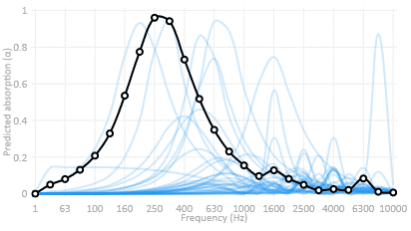
Case studies
Population member
Best candidate (so far)
Notes:
As the parameters were somewhat «given», i wanted to find out how they would influence the algorithm.

Slide 12
Case studies
Population member
Best candidate (so far)
Notes:
As the parameters were somewhat «given», i wanted to find out how they would influence the algorithm.

Slide 13
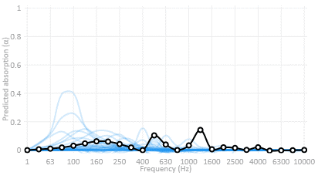
Population size
Notes:
As the parameters were somewhat «given», i wanted to find out how they would influence the algorithm.

Slide 14
Population size
Notes:
As the parameters were somewhat «given», i wanted to find out how they would influence the algorithm.

Slide 15
Crossover rate
Behaves as expected: Low values cause slow convergence, high values cause fast convergence
No notable difference in results.

Slide 16
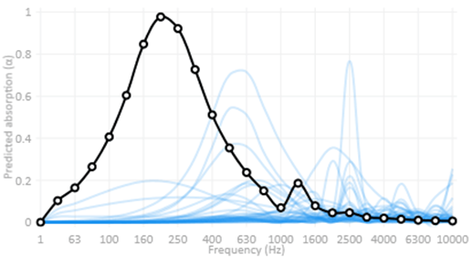
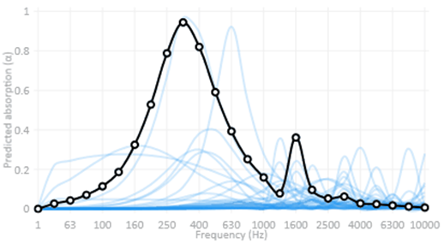

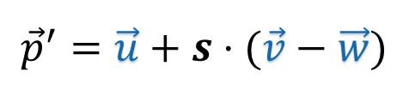
Shift factor
$${\vec{p}}^{′}=\vec{u}+s⋅(\vec{v}−\vec{w})$$
0.1 shift factor
0.9 shift factor
Shift factor $\hat{=}$ “How much does the cuboid shrink”

Slide 17
Shift factor
$${\vec{p}}^{′}=\vec{u}+s⋅(\vec{v}−\vec{w})$$
0.1 shift factor
0.9 shift factor
Shift factor $\hat{=}$ “How much does the cuboid shrink”

Slide 18
Thank you!

